Slide 1
Project Proposal: Animal Detection Hyper Device
Hubert Waleńczak
220817

Slide 2
Ordered Table of Contents
Value Proposition: What computer vision application will you make and why is it’s added value?
Proof-of-Concept: How will my Computer Vision Algorithm work?
Explainable AI: How does my AI work?
Responsible AI: Why is my AI ethical?
Disruptive Technology risks: What disruptive technology risks am I facing?
Application Design: How will my computer vision application work?
[Delete this slide before final submission]

Slide 3
Value proposition
Business Understanding Components
Try to convey as much of the following requirements on the AI Canvas on the next slide as possible.
Use separate slides to:
  Conduct market research & target audience analysis
  Argue for proposal feasibility
ILO Mapping: POOR, INSUFFICIENT
Business Understanding Requirements:
Conduct research into overall consumer market ( User case 1);
Based on the conducted research generate an idea for an overall consumer market ( User case 1);
Identify your actual customers and their needs by conducting segmentation, targeting and creating a user persona for your application ( User case 2);
Adjust your project proposal for an application based on the needs of your customers ( User case 2);

Slide 4
Research into overall consumer market​
What classifier product/product feature could make customers' lives easier? ​Real-time wild animal detecton through cameras with ability to deter wild animals. This would enable farmers to take action immediately when a wild animal is detected and prevent crop damage.
How can I improve my customers' experience? Notify user about detection of animal in area of remote crop fields and try to drive animal away by producing loud sound.
What problem can I alleviate for my customers?​ The wild animal detection system can limit the problem of crop damage caused by wild animals, reducing the financial losses and stress experienced by farmers.
What are the unmet needs of my customers?​ Surveillance system for remote crop fields with more effective deterrent system, or a more affordable price point.
Are current products on the market meeting customers' expectations? If not, what is lacking?​
PREDATORGUARD is a producer of high end motion activated powerful LED flashlight to scare off animals. No notification or monitoring as a unit, is not effective at scaring off some animals.
Bell+Howell Solar Animal Repeller is an ultrasonic motion activated repeller.

Slide 5
Sources for market research:
https://viso.ai/applications/computer-vision-in-agriculture/​
https://www.researchgate.net/publication/344387269_Wild_Animals_Intrusion_Detection_using_Deep_Learning_Techniques​
https://towardsdatascience.com/detecting-animals-in-the-backyard-practical-application-of-deep-learning-c030d3263ba8​
https://solarpowernerd.com/solar-powered-animal-repeller/
https://www.amazon.com/dp/B003USMX7M?tag=solarpowernerd-20&linkCode=ogi&th=1&psc=1
https://www.amazon.com/dp/B00E51X8Q8?tag=solarpowernerd-20&linkCode=ogi&th=1

Slide 6
Project proposal:
Wild animal detection computer vision integrated into deterant system with bright LED lights and high-pitch sounds.

Slide 7
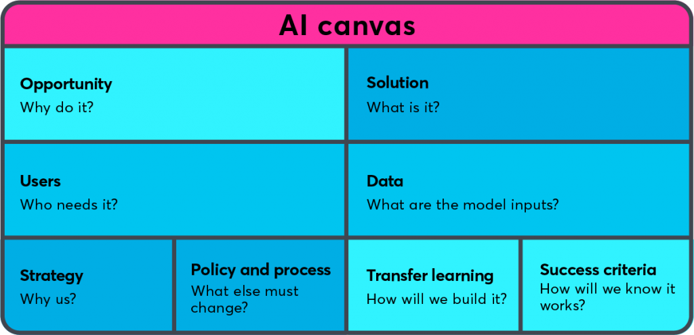
AI Canvas: provide high-level overview
Wild animals are destroying crops and terrorizing citizens
An application that detects animals and notifies clients
An Image from Imsitu database and DuckDuckGo images
Farmers and municipality
SKIP THIS PART
Xception base with additional convolutional layers
PoC
DISRUPTIVE TECH RISKS

Slide 9
Responsible AI (Fairness & Bias)
Bias, fairness, transparency and interpretability
There are very few pictures containing people of color in the dataset, and certain activities seem to be largely dominated by a particular group of individuals, such as yoga, which appears to have fewer male participants and a larger female demographic.
Some activities can be associated with specific groups, which can harm those groups or outside groups. For instance, in the context of computer vision models detecting people performing yoga, there can be bias in the way the model is trained, which can lead to discriminatory outcomes. In particular, the model may be biased towards certain characteristics that are more commonly associated with the dominant group of people who typically practice yoga, such as women, and thus be less effective at detecting individuals from underrepresented groups, such as men.

Slide 10
Proof-of-Concept: Deep Learning
Present the final model you developed on the use-case you selected.
The dataset
Baselines
Preprocessing
CNN architecture
CNN training
Model performance
Error analysis
Iteration
ILO Mapping: The PoC slides relate to ILO 4.1 Sufficient & Good criteria

Slide 11
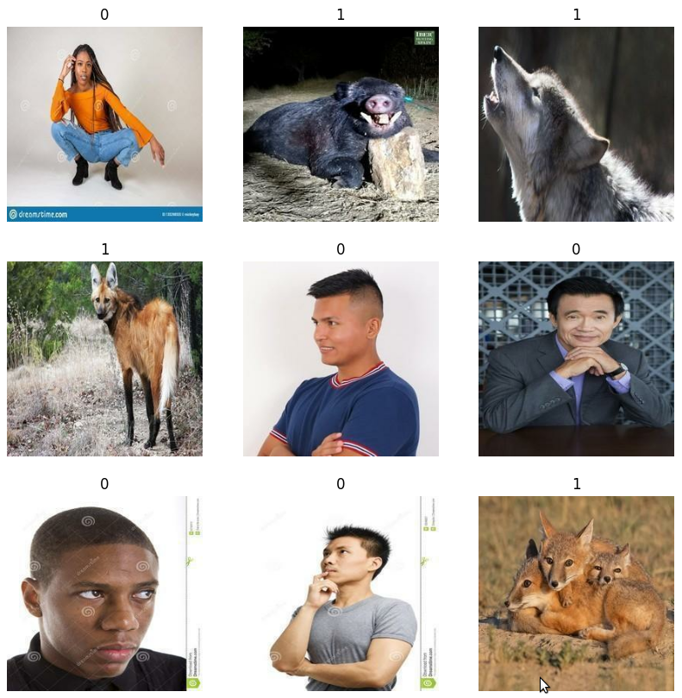
PoC: The dataset
Binary classification (is there an animal?)
Show a few examples per class
2 classes
820 and 818 images of Animals and Humans respectively packed into batches of 32
70/20/10% train/validation/test split
Each image has been resized to 256x256 pixels
The images are labeled 0 if there is no animal and 1 if there is one
An Image from the ImSitu database and scraped DuckDuckGo images

Slide 12
PoC: Baselines
Random guess accuracy: 50%
Human-Level Performance: 100%
Multilayer Perceptron accuracy: 72.5%

Slide 13
PoC: Preprocessing
The images were rescaled to 256x256 pixels.
Corrupt images have been removed
Images have been filtered and pictures containing humans have been equally distributed among all gender and races
Data augmentation layers such as random horizontal flip and random rotation

Slide 14
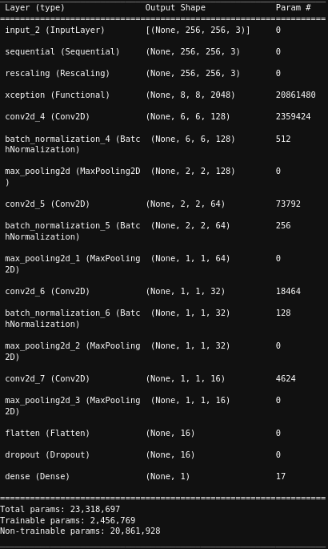
PoC: CNN architecture
Transfer learning has been used with 4 convolutional layers, 3 batch normalization layers, 4 Maxpooling layers, 1 flatten layer, 1 dropout layer and a single output neuron

Slide 15
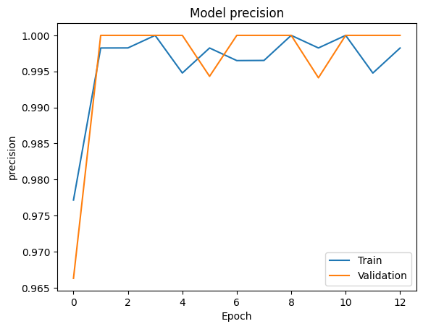
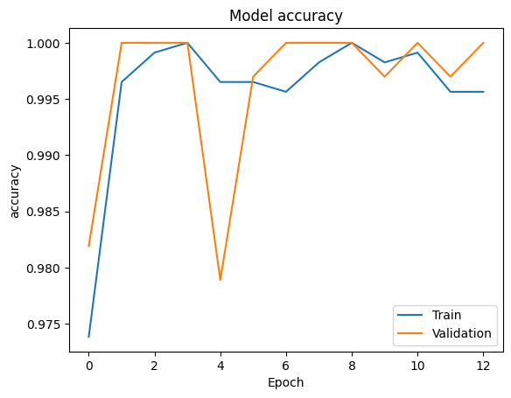
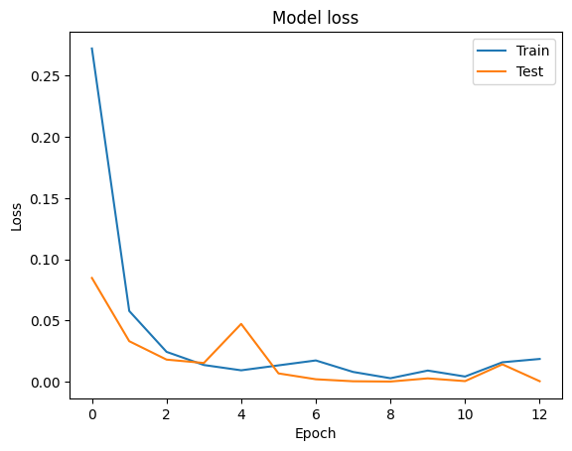
PoC: CNN training
The model uses binary_crossentropy as a loss function since it is a binary classification problem
Adam optimizer has been used as it has a very good overall performance
Apart from validation loss, accuracy and precision were used as an overall additional metric to check how well the model distinguishes animals from different pictures

Slide 16
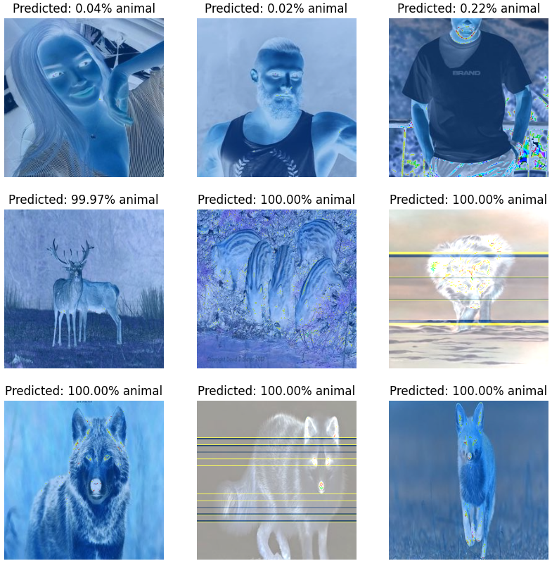
PoC: Model performance
Loss: 0.00079993, accuracy: 1.0000, precision: 1.0000

Slide 17
PoC: Best CNN from scratch Model

Slide 18
PoC: Error analysis
The model is accurate at detecting animals on images it didn’t see douring training
Modle focuses on nose, eyes, fur and ears

Slide 19
PoC: Iteration
You have described your finalized model. Explain how you got here from the very first model you created. Describe a minimum of two iterations you did.
First model had data agumentatio, 4 convolutional leyers, 4 max pooling layers , dropout layer and dense sigmoid activated layer

Slide 20
PoC: Transfer Learning Model
Transfer learning has been used with 4 convolutional layers, 3 batch normalization layers, 4 Maxpooling layers, 1 flatten layer, 1 dropout layer and a single output neuron

Slide 21
Responsible AI (Transparency & Interpretability)
Bias, fairness, transparency and interpretability
ILO Mapping:
(Partially) ‘Sufficient’, and ‘Good’ criteria of ILO 3.1.
Requirements:
Discuss the trade-off between accuracy and interpretability of your AI model (applied to the Creative Brief)
Develop an AI model that balances accuracy and interpretability (applied to the Creative Brief)

Slide 22
Business Understanding Components
AI Canvas
  Conduct the disruptive technology risk assessment based on the lecture provided during Data lab
  How can I eliminate risks?
ILO Mapping: GOOD, EXCELLENT
Requirements:
The student conducts assessment of disruptive technology risks associated with proposed application ( Use-Case 3);
The student improves proposal for an application based on the assessment of disruptive technology risks (Use-Case 3).
[remove this slide before submission]

Slide 23
Disruptive Technology Risks
Risks
Contingency Plan
[Some high-level plan]

Slide 24
HCAI - Application Design:
High-level concept design:
Reiterate:
Who is the user?
What problem are you solving?
How is the app going to solve that problem?
What else is important to your app? For example:
Menu Flow?
Information flow?
Colors styles?
Interaction style?
ILO Mapping: Poor & Excellent

Slide 25
HCAI - Application Design
Algorithm Embedding:
How is the computer vision algorithm embedded?
What will the eventual algorithm detect and how?
Will the algorithm be able to do more then demonstrated in the proof-of-concept?
ILO Mapping: Poor & Sufficient

Slide 26
HCAI - Application Design:
Continuous Learning
How does the application design allow for continual (supervised) learning based on user input? Meaning users can label data and/or output, E.g.:
  annotate pictures;
  other data labelling means;
  rate predictions/model output.
ILO Mapping: Poor & Sufficient

Slide 27
HCAI - Application Design:
Feedback
User tests results?
Client feedback?
What was processed and how?
Design implications?
ILO Mapping: Insufficient, Sufficient & Good

Slide 28
HCAI - Application Design:
Low-level design:
Detailed design of the application
How your application adds value to fundamental processes of the user case
Everything which doesn’t fit into the other boxes usually goes here…
  Note that you might want to explain aspects of the low-level design using your wireframe if possible!
E.g.
  User will receive notifications to do…
  To improve user retention, a competitive system is introduced which does…
  To warn the user for Y, a yellow colour will be used for X
ILO Mapping: Excellent

Slide 29
HCAI - Application Design:
Wireframe Prototype:
Some demo…
  This is where you will actually demonstrate your wireframe to the client. You can either open your wireframe, have a link here, a video demo of you using the wireframe; as long as you clearly convey you app design using the wireframe…
ILO Mapping: Poor, Sufficient, Good & Excellent

Slide 30
Thank you!
Any questions?

